Slide 1


Slide 2

Topics
Random Forest
Bootstrapping
Model Validation – K-fold
Hands-On Activity: Churn Prediction Model

Slide 3
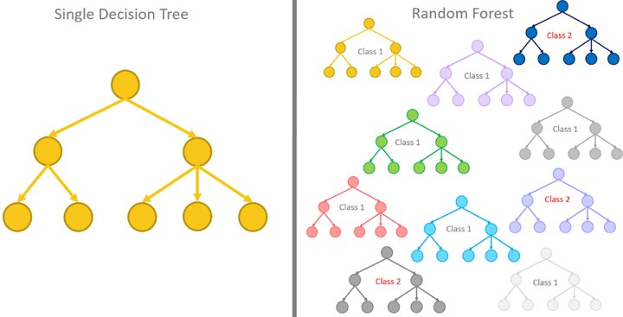
Random Forest
Random Forest is another family of predictive algorithms which suggests rather than relying only on one decision tree, why don’t we make a forest of trees and then based on those multiple tree learnings make a final democratic decision for the final prediction?​
Notes:
Decision trees are highly sensitive to training data, resulting in high variance.

Slide 4
Random Forest
The fundamental concept behind random forest is a simple but powerful one — the wisdom of crowds.
A large number of relatively uncorrelated models (trees) operating as a committee will outperform any of the individual constituent models.
Notes:
The low correlation between models is the key. Just like how investments with low correlations (like stocks and bonds) come together to form a portfolio greater than the sum of its parts, uncorrelated models can produce ensemble predictions that are more accurate than any individual predictions.
This wonderful effect is because the trees protect each other from their individual errors (as long as they don’t constantly all err in the same direction).

Slide 5
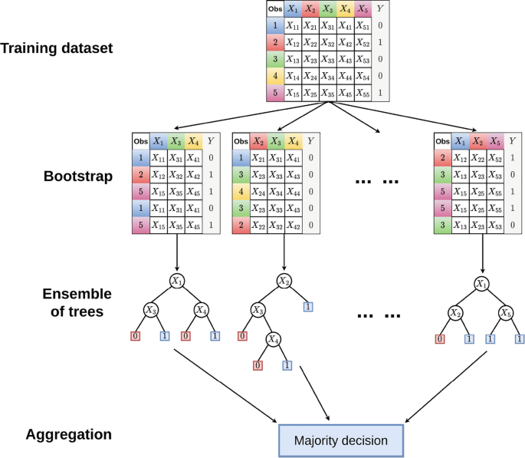
Random Forest
Chooses a random sample/random subset from the entire data set with a replacement. (Bootstrap)
2. Now each model is trained independently, which generates results.
3. The final output is based on majority voting after combining the results of all models.
Notes:
Steps Involved in Random Forest Algorithm
Step 1: In the Random forest model, a subset of data points and a subset of features is selected for constructing each decision tree. Simply put, n random records and m features are taken from the data set having k number of records.
Step 2: Individual decision trees are constructed for each sample.
Step 3: Each decision tree will generate an output.
Step 4: Final output is considered based on Majority Voting or Averaging for Classification and regression, respectively

Slide 6
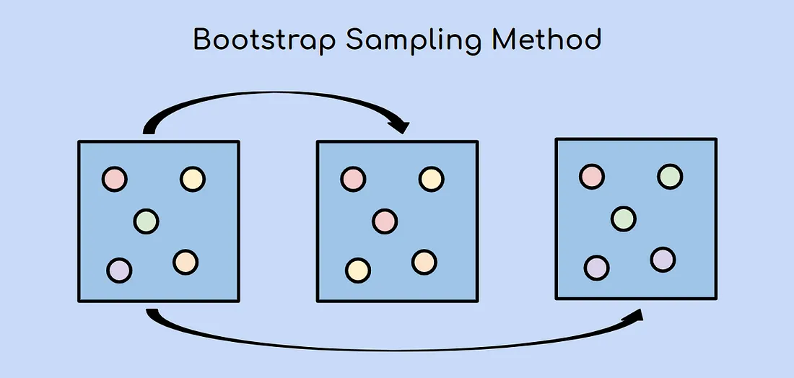
Bootstrapping
The bootstrap sampling method is a resampling method that uses random sampling with replacement.

Slide 7
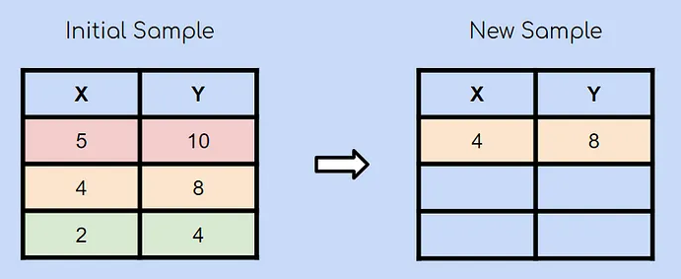
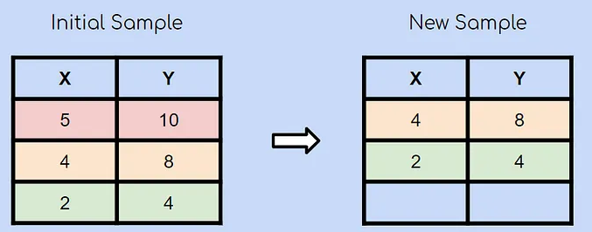
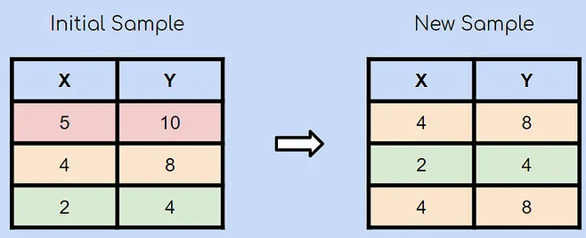
Bootstrapping
Notes:
Suppose you have an initial sample with 3 observations. Using the bootstrap sampling method, you’ll create a new sample with 3 observations as well. Each observation has an equal chance of being chosen (1/3). In this case, the second observation was chosen randomly and will be the first observation in our new sample.
After choosing another observation at random, you chose the green observation.
Lastly, the yellow observation is chosen again at random. Remember that bootstrap sampling using random sampling with replacement. This means that it is very much possible for an already chosen observation to be chosen again
Generally, 2/3rd of the data is used for a bootstrap sample.
Feature selection is also important, in bootstrapping, a subset of feature is selected for each sample. So that, each tree is trained on different features, reducing the correlation. How many features to select? Researchers have found generally a square root of total features is ideal.

Slide 8
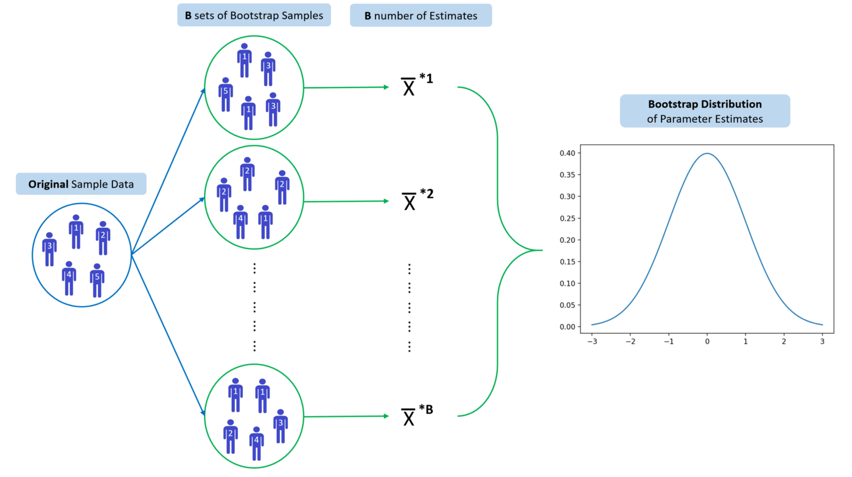
Importance of Bootstrapping
“Bootstrap aggregating” or Bagging is a technique used in many ensemble machine learning algorithms like random forests, AdaBoost, gradient boost, and XGBoost.
Estimating the parameters of a population (i.e. mean, standard error), you may have a sample that is not large.
Notes:
As you learn more about machine learning, you’ll almost certainly come across the term “bootstrap aggregating”, also known as “bagging”. Bagging is a technique used in many ensemble machine learning algorithms like random forests, AdaBoost, gradient boost, and XGBoost.
Sometimes when estimating the parameters of a population (i.e. mean, standard error), you may have a sample that is not large enough to assume that the sampling distribution is normally distributed.
In essence, under the assumption that the sample is representative of the population, bootstrap sampling is conducted to provide an estimate of the sampling distribution of the sample statistic in question.

Slide 9
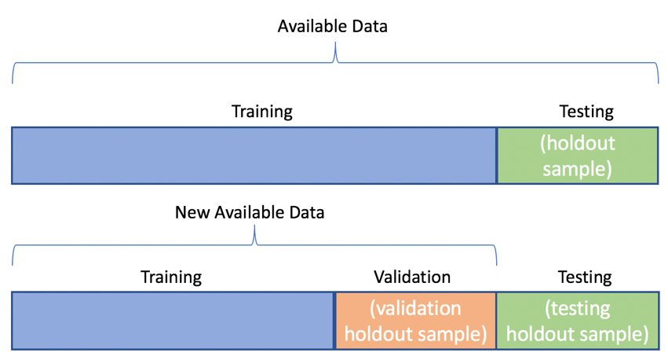
Cross Validation
Cross-validation can be used to detect overfitting in a model which infers that the model is not effectively generalizing patterns and similarities in the newly inputted data.
The overall aim of Cross-Validation is to use it as a tool to evaluate machine learning models, by training several models on different subsets of the input data.

Slide 10
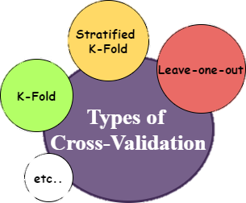
Cross Validation
There are different types of Cross-Validation techniques
Hold-out
K-folds
Leave-one-out
Leave-p-out
However, we will be particularly focusing on K-folds.
Notes:
Hold-out: Hold-out is the simplest form of cross-validation. It involves randomly dividing the dataset into two parts: a training set and a validation set. The model is trained on the training set and evaluated on the validation set.
K-fold: In K-fold cross-validation, the dataset is divided into K equal-sized folds. The model is trained on K-1 folds and evaluated on the remaining fold. This process is repeated K times, with each fold being used as the validation set once.
Leave-one-out: In leave-one-out cross-validation, each observation in the dataset is used as the validation set once, while the rest of the data is used for training. This means that the number of folds is equal to the number of observations in the dataset.
Leave-p-out: Leave-p-out is similar to leave-one-out, but instead of leaving out one observation at a time, we leave out p observations (and all possible combinations of p) at a time. This allows for a more efficient use of computational resources, as we can reduce the number of folds and still obtain a good estimate of the model's performance.

Slide 11
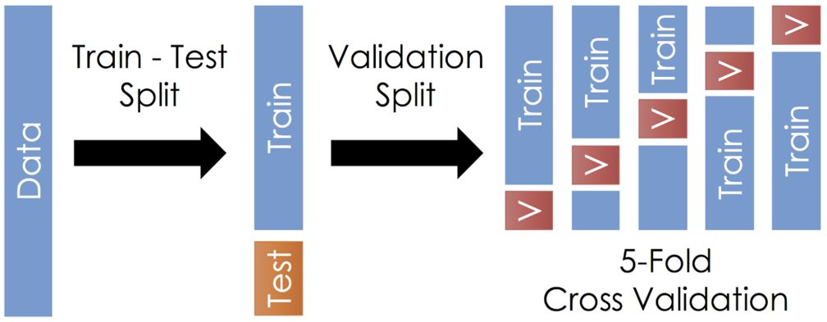
K-Folds
In this case, K=5

Slide 12

THANK YOU
Training and Certification

